Slide 1
Lecture 2

Slide 2
Why Deep Learning ?
Why Deep Learning for Artificial Intelligence ?
See
Hear
Language
Control

Slide 3
Lecture 2 Introduction to Machine Learning
Dr. Tehseen Zia
CIIT, Islamabad

Slide 4
Contents
What is machine learning ?
Why it is useful ?
How it can be ?

Slide 5
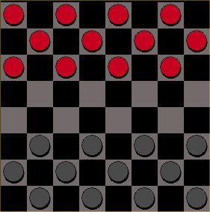
What is Machine Learning ?
Field of study that gives computer the ability to learn without being explicitly programmed (Arthur Samuel, 1956)
Study of algorithms that improve their performance P at some task T with experience E (Tom Mitchell, 1998)
T: Play checkers
P: % of games won
E: Playing against self
Well defined learning task: <P, T, E>

Slide 6
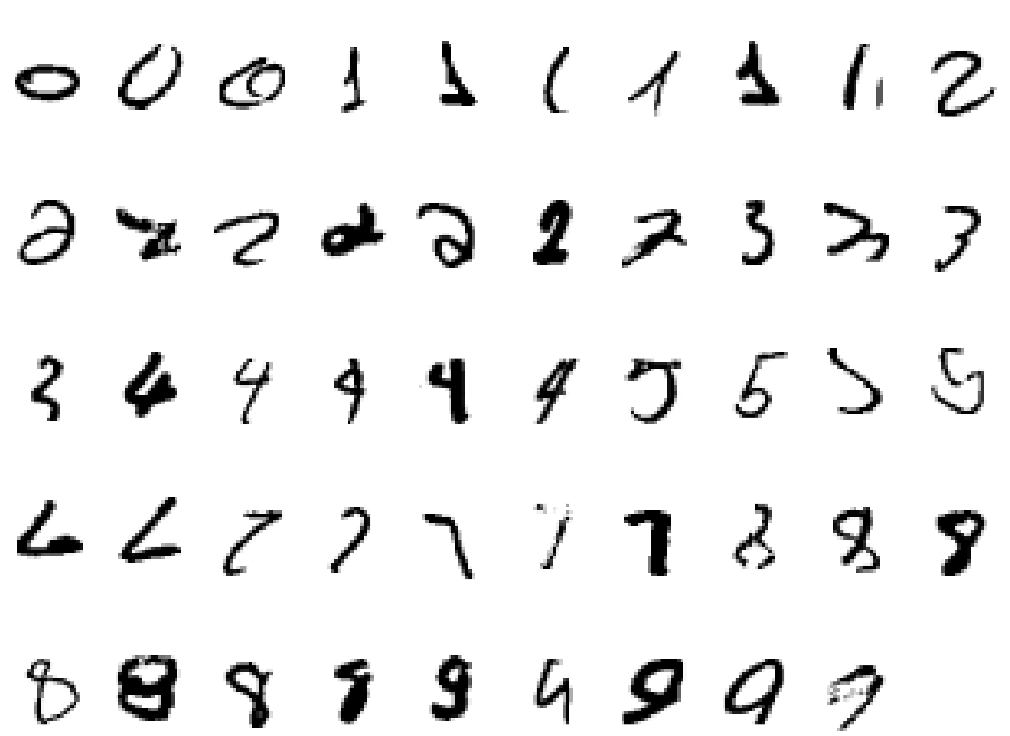
Well Defined Learning Task
Handwriting Recognition
Task T: recognizing and classifying handwritten words within images
Performance P: percent of words correctly classified
Training experience E: a database of written words with given classification

Slide 7
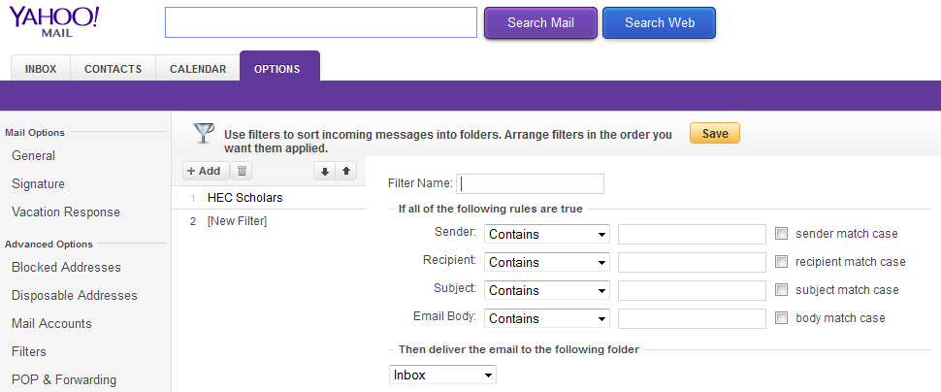
Question
Suppose your email program watches which email you do and do not mark as spam and based on that learn how to better filter spam. What is the task in this setting
Classifying emails as spam or not spam
The number of emails correctly classifying as spam/not spam
Labelling emails as spam/ not spam
Non of above: This is not a machine learning problem

Slide 8
Machine Learning Algorithms
Supervised Learning Algorithms
Unsupervised Learning Algorithms
Reinforcement Learning

Slide 9
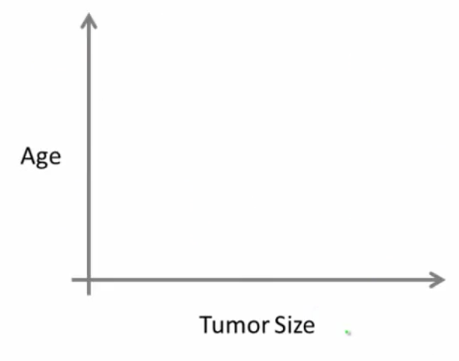
Supervised Learning
Breast Cancer: (Malignant, Benign)
Right answers are given for inputs
Classification refers to predict discrete valued output (e.g. 0 or 1)

Slide 10
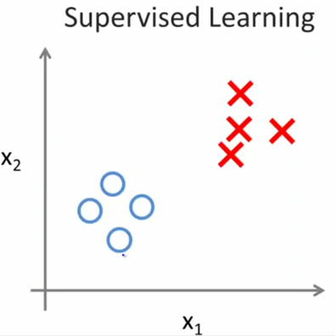
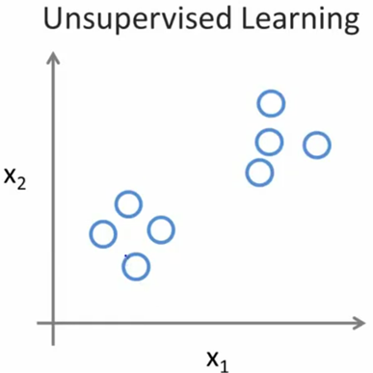
Unsupervised Learning

Slide 11
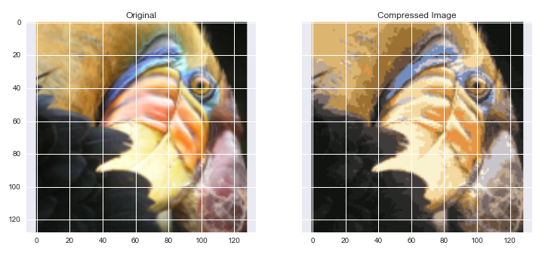
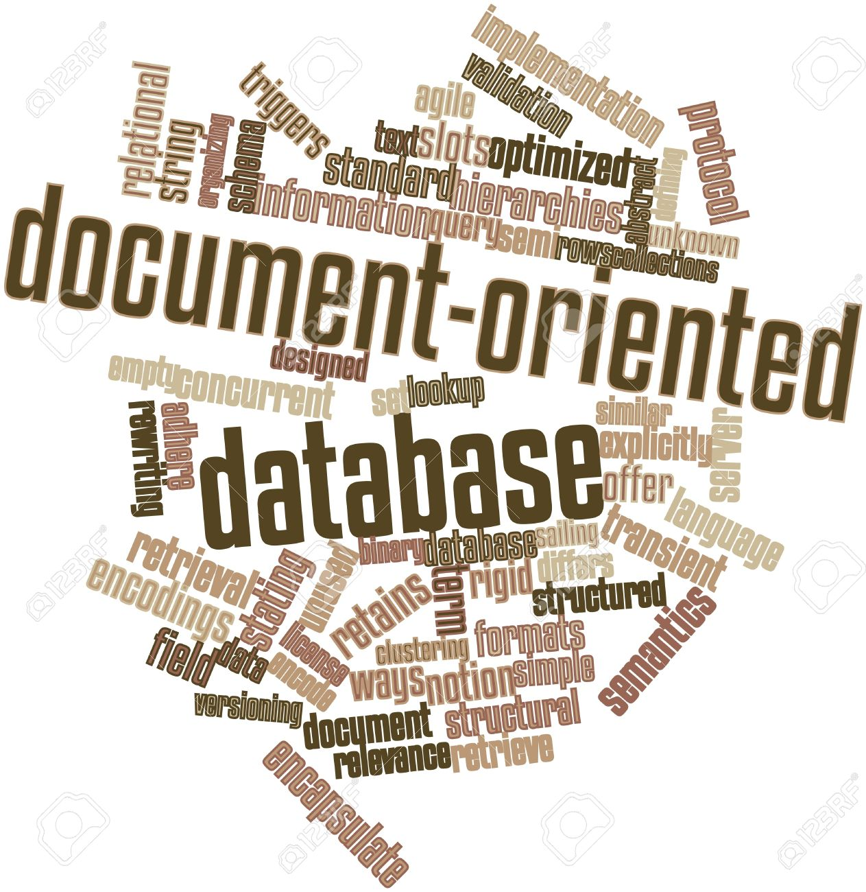

Slide 12
Question
Of following examples, which one you address using unsupervised learning algorithm?
Given email labelled as spam/not spam, learn a spam filter
Given a set of news articles on the web, group them into set of articles about the same story
Given a database of customer data, automatically discover market segments and group customer into different market segments
Given a database of patients diagnosed as either having diabetes or not, learn to classify a new patients as either having a diabetes or not.

Slide 13
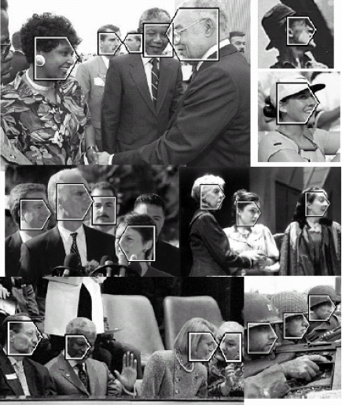
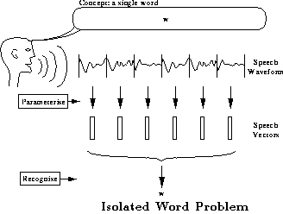
Why It Is Useful ?
ML learning provides best methods for developing particular kinds of software, in applications where:
Application is too much complex for people to manually design the algorithm. For instance, soft- wares for sensor-based prediction tasks such as speech recognition and computer vision.

Slide 14
Why It Is Useful ? (Cont.)
ML learning provides best methods for developing particular kinds of software, in applications where:
Application is too much complex for people to manually design the algorithm.
What makes a 2?

Slide 15
Why It Is Useful ? (Cont.)
ML learning provides best methods for developing particular kinds of software, in applications where:
2. it is easier to collect data and label training data than writing an algorithm, ML is a software development method of choice.

Slide 16
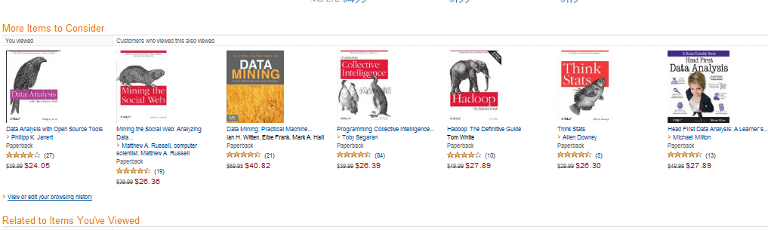
Why It Is Useful ? (Cont.)
ML learning provides best methods for developing particular kinds of software, in applications where:
3. Applications require that the software customize to its operational environment after it is fielded. For example, speech recognition system that customize to the user who purchase the software or recommenders

Slide 17

Why It Is Useful ? (Cont.)
ML learning provides best methods for developing particular kinds of software, in applications where:
3. Applications require that the software customize to its operational environment after it is fielded. For example, speech recognition system that customize to the user who purchase the software or recommenders

Slide 18
Why It Is Useful ? (Cont.)
ML learning provides best methods for developing particular kinds of software, in applications where:
4. Using historical data to improve decisions (task is known as Data Mining), e.g. Medical record – medical knowledge, what kind of medical treatment is suitable for which patients in future.

Slide 19
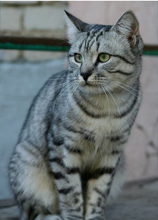
How It Can be ?
Classification
Image Classification: A Core Computer Vision Task
Machine Learning
Cat
Dog
Car
Truck
Person
.
.
.
Cat

Slide 20
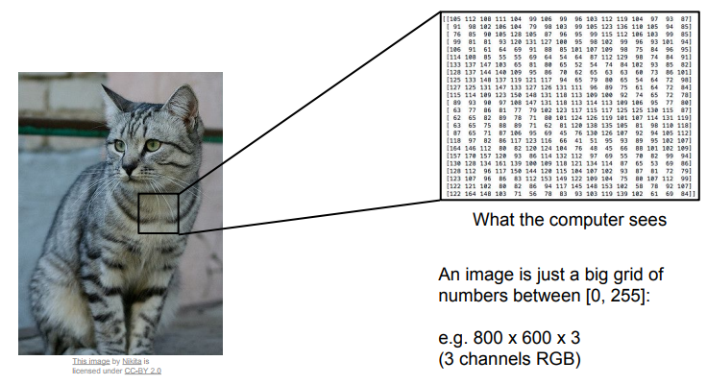
Semantic Gap
What you see

Slide 21
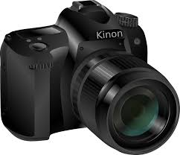
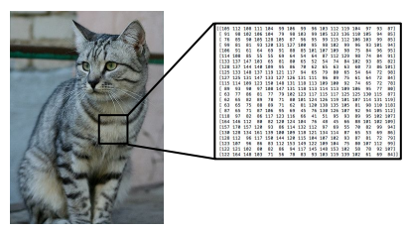
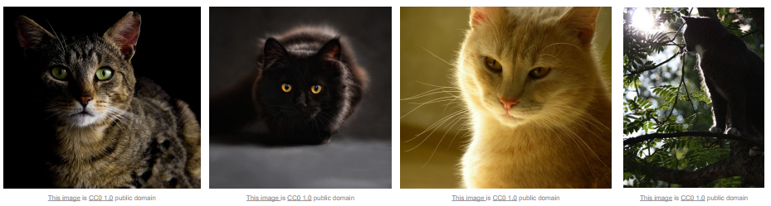
Why Not Hard-Coded ?
Viewpoint variation
Illumination

Slide 22
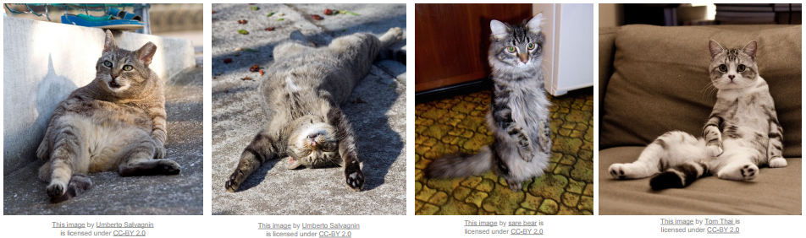
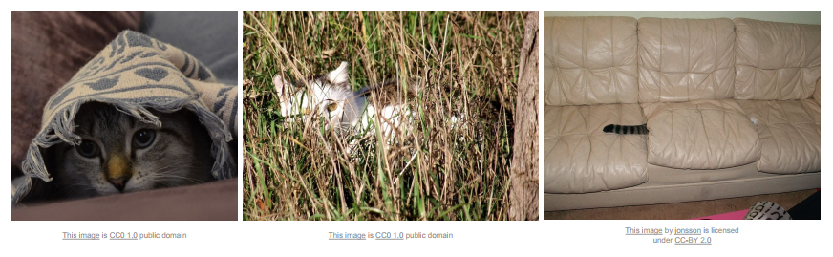
Why Not Hard-Coded ? (Cont.)
Deformation
Occlusion

Slide 23
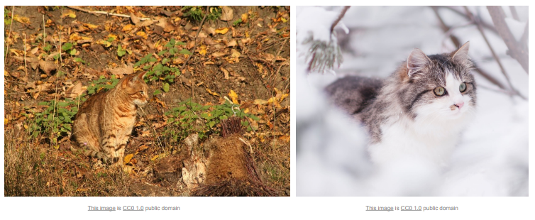
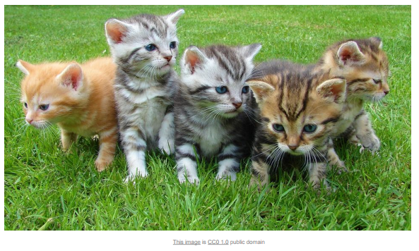
Why Not Hard-Coded ? (Cont.)
Background Clutter
Intra Class Variation

Slide 24
Image Classifier
Cannot be hard-coded like sorting algorithms
Data Driven Approach: Machine Learning (ML)
Input: Collect a dataset of images and labels
Learning: Use ML algorithm (known as learner) to train a classifier
Evaluation: Evaluate the classifier on new images

Slide 25
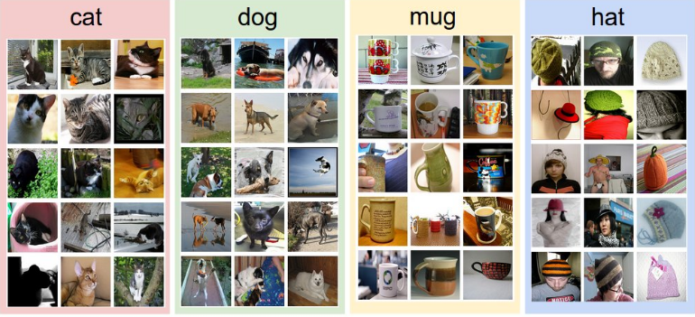
Simplest Learner: No Learner
Just store images and labels in a database
Predict labels of most similar training images

Slide 26
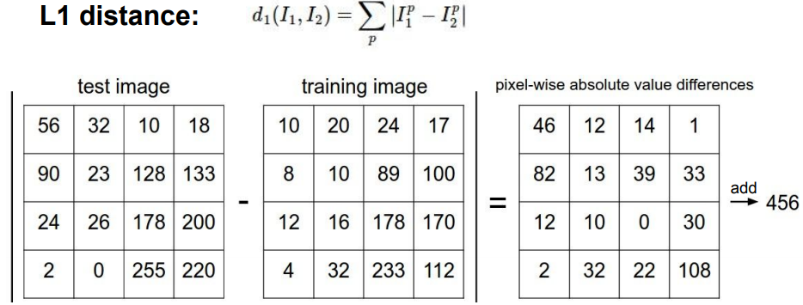
Finding Similarity
To find similarity between images, use distance metrics e.g.

Slide 27
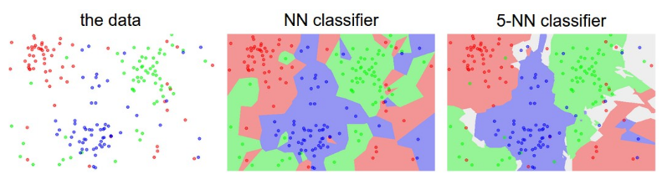
K-Nearest Neighbors
Instead of copying label from nearest neighbor, take majority vote from K closest points

Slide 28
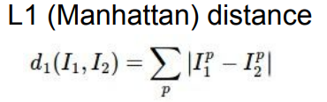
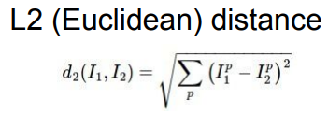
K-Nearest Neighbors: Distance Metric

Slide 29
What are Hyperparameters ?
The values of the parameters that we set rather than learning, For example
What is the best value of K to use?
What is the distance metric to use?
Try different values to find the optimal ones

Slide 30
Setting Hyperparameters
Train test split:
Cross validation:
Notes:
Train/test split: Little test data is used as proxy to check generalized performance of the hyperparameter/ method. It reduces training data, harmful is training data is already small.

Slide 31
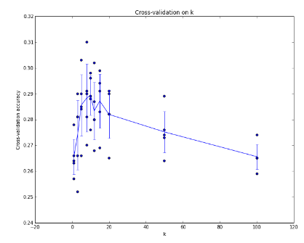
Setting Hyperparameters
K = 7 works best in this case

Slide 32
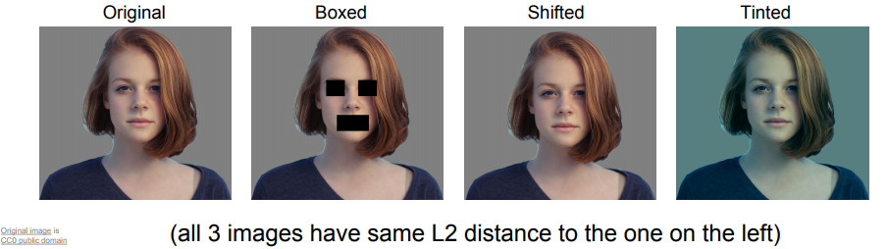
Drawbacks of K-Nearest Neighbors
Very slow at test time
Distance metrics on pixels are not informative

Slide 33
Reading Material
Image Classification Tutorial: http://cs231n.github.io/classification/
A Few Useful Things About Machine Learning: https://homes.cs.washington.edu/~pedrod/papers/cacm12.pdf

Slide 34
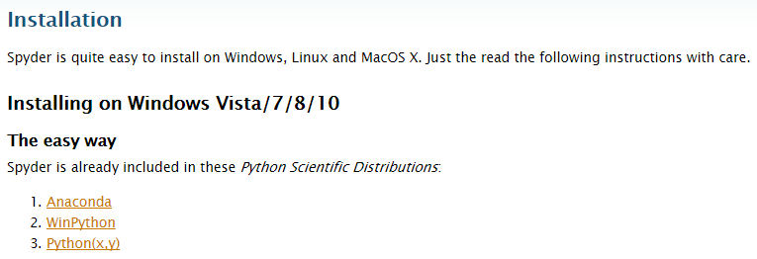
Python Installation
Step 1: Install Anaconda (https://pythonhosted.org/spyder/installation.html )

Slide 35
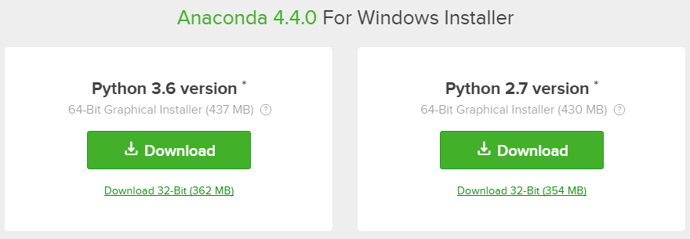
Python Installation
Versions of Anaconda

Slide 36
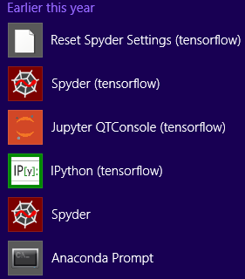
Spyder Installation
Step 2: Install Spyder
Open Anaconda Prompt
Type command: pip install spyder

